Slide 1




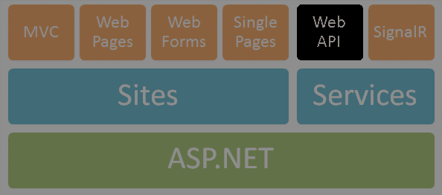

ASP.NET Web API
SoftUni Team
Technical Trainers
Software University
http://softuni.bg

Slide 2


Table of Contents
What is ASP.NET Web API?
Web API Features
Demo: Default Project Template
Web API Controllers
Routes
Demo: Create API Controller
OData queries
Web API Clients
Demo: Consuming Web API

Slide 3

What is ASP.NET Web API?

Slide 4
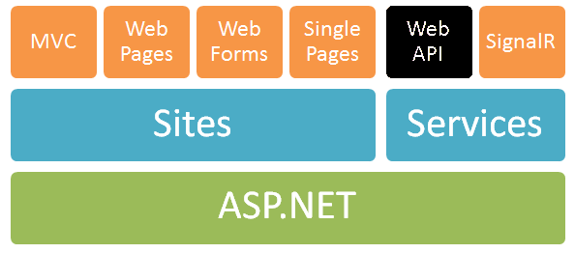
ASP.NET Web API
ASP.NET Web API == platform for building RESTful Web services
Running over the .NET Framework
Using the ASP.NET development stack

Slide 5
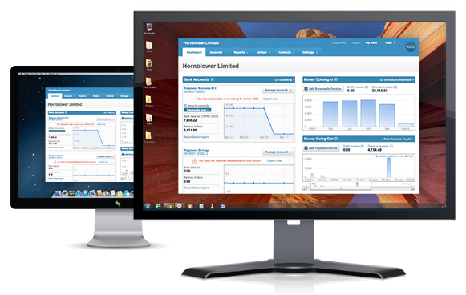


ASP.NET Web API
Data storage
XML
HTTP GET
JSON
Data Layer (EF)
ASP.NET Web API
Models
JSON
XML
HTTP PUT, POST, DELETE

Slide 6
Web API Features
Easy to use framework, very powerful
Modern HTTP programming model
Access to strongly typed HTTP object model
HttpClient API – same programming model
Content negotiation
Client and server negotiate about the right data format
Default support for JSON, XML and Form URL-encoded formats
We can add own formats and change content negotiation strategy

Slide 7
Web API Features (2)
Query composition
Support automatic paging and sorting
Support querying via the OData URL conventions when we return IQueryable<T>
Model binding and validation
Combine HTTP data in POCO models
Data validation via attributes
Supports the same model binding and validation infrastructure as ASP.NET MVC

Slide 8
Web API Features (3)
Routes (mapping between URIs and code)
Full set of routing capabilities supported within ASP.NET (MVC)
Filters
Easily decorates Web API with additional validation
Authorization, CORS, etc.
Testability
IoC and dependency injection support
Flexible hosting (IIS, Azure, self-hosting)

Slide 9
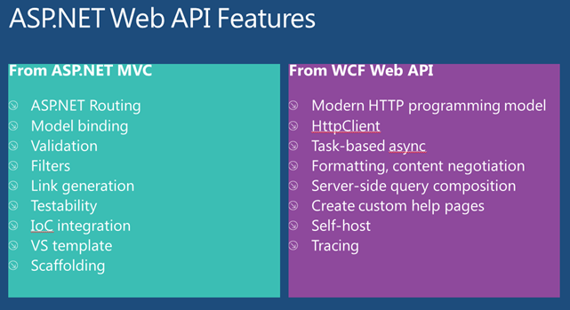
Web API Features (4)
Visual Studio IDE (+templates and scaffolding)
Reuse of C# knowledge (+ task-based async)
Custom help pages, tracing, etc.

Slide 10
ASP.NET Web API 2
Attribute routing
OData improvements: $select, $expand, $batch, $value and improved extensibility
Request batching
Portable ASP.NET Web API Client
Improved testability
CORS (Cross-origin resource sharing)
Authentication filters
OWIN support and integration (owin.org)

Slide 11
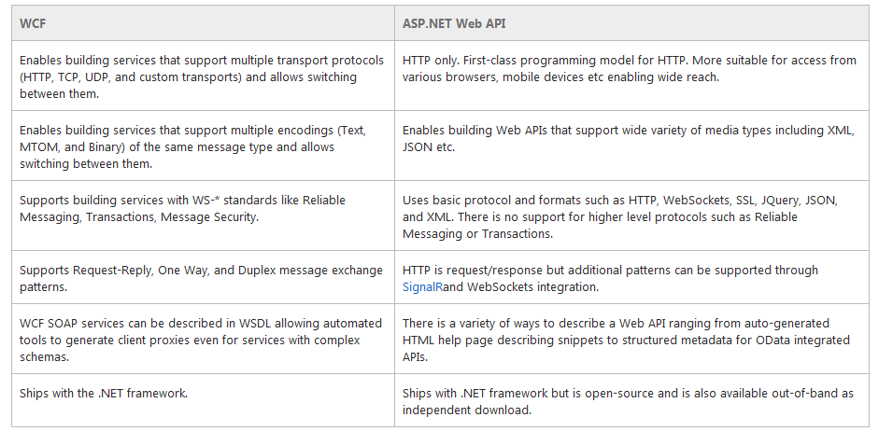
WCF vs. ASP.NET Web API
WCF is also a good framework for building Web services

Slide 12
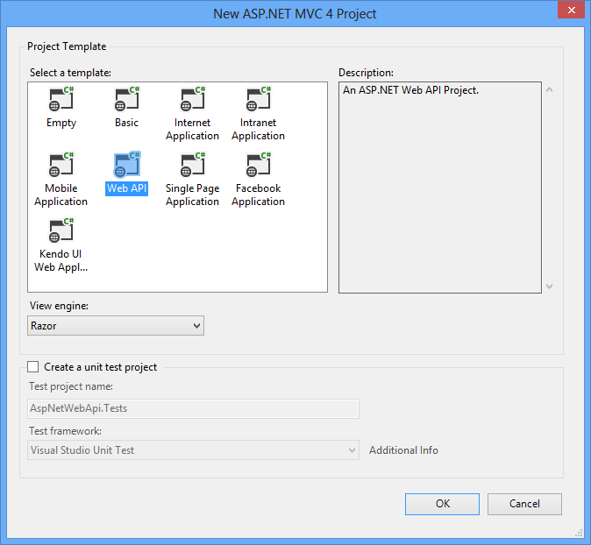
Creating ASP.NET Web API Project
Default ASP.NET Web API Project Template

Slide 13

Web API Controllers

Slide 14
Web API Controllers
A controller class handles HTTP requests
Web API controllers derive from ApiController
ASP.NET Web API by default maps HTTP requests to specific methods called "actions"
Action | HTTP method | Relative URI | Method
Get a list of all posts | GET | /api/posts | Get()
Get a post by ID | GET | /api/posts/id | Get(int id)
Create a new post | POST | /api/posts | Post(PostModel value)
Update a post | PUT | /api/posts/id | Put(int id, PostModel value)
Delete a post | DELETE | /api/posts/id | Delete(int id)
Get a post by category | GET | /api/posts?category=news | Get(string category)

Slide 15
Web API Default Behavior
1
2
3
Web Request
Match a Route
API Controller Responds
http://localhost:1337/api/posts
HTTP GET Request
Controller Name
public class PostsController : ApiController
{
public string Get()
{
return "Some data"; }
}

Slide 16
Routing
Routing == matching URI to a controller + action
Web API support the full set of routing capabilities from ASP.NET (MVC)
Route parameters
Constraints (using regular expressions)
Extensible with own conventions
Attribute routing is available in version 2

Slide 17
Default Route
Web API also provides smart conventions by default
We can create classes that implement Web APIs without having to explicitly write code
HTTP Verb is mapped to an action name
http://localhost:1337/api/posts
routes.MapHtpRoute(name: "DefaultApi",
routeTemplate: "api/{controller}/{id}",
defaults: new { id = RoutesParameter.Optional });

Slide 18
Model Binding & Formatters
By default the Web API will bind incoming data to POCO (CLR) types
Will look in body, header and query string
ASP.NET MVC has similar model binder
MediaTypeFormatters are used to bind both input and output
Mapped to content types
Validation attributes can also be used
To go down further into the HTTP (set headers, etc.) we can use HttpRequestMessage and HttpResponseMessage

Slide 19
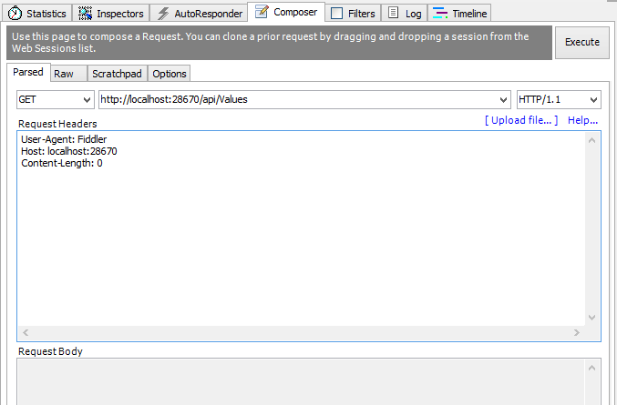
Demo: Create API Controller

Slide 20
Return Different HTTP Code
By default when everything is OK, we return HTTP status code 200
Sometimes we need to return error
public HttpResponseMessage Get(int id)
{
if (dataExists)
{
return Request.CreateResponse(HttpStatusCode.OK, data);
} else
{
return Request.CreateErrorResponse( HttpStatusCode.NotFound, "Item not found!");
} }

Slide 21
OData Query Syntax
OData (http://odata.org) is a open specification written by Microsoft
Provide a standard query syntax on resources
Implemented by WCF Data Services
ASP.NET Web API includes automatic support for this syntax
Return IQueryable<T> instead of IEnumerable<T>

Slide 22
OData Query Syntax
To enable OData queries uncomment the line:
"config.EnableQuerySupport();"
Then we can make OData queries like:
http://localhost/Posts?$top=2&$skip=2
Option | Description
$filter | Filters the results, based on a Boolean condition.
$inlinecount | Tells the server to include the total count of matching entities in the response.
$orderby | Sorts the results.
$skip | Skips the first n results.
$top | Returns only the first n the results.

Slide 23

Web API Clients

Slide 24
HttpClient Model
HttpClient is a modern HTTP client for .NET
Flexible and extensible API for accessing HTTP
Has the same programming model as the ASP.NET Web API server side
HttpRequestMessage / HttpResponseMessage
Uses Task pattern from .NET 4.0
Can use async and await keywords in .NET 4.5
Installs with ASP.NET MVC 4
Can be retrieved via NuGet

Slide 25
HttpClient – Example
var client = new HttpClient {BaseAddress = new Uri("http://localhost:28670/") };
client.DefaultRequestHeaders.Accept.Add(new
MediaTypeWithQualityHeaderValue("application/json"));
HttpResponseMessage response = client.GetAsync("api/posts").Result;
if (response.IsSuccessStatusCode)
{
var products = response.Content
.ReadAsAsync<IEnumerable<Post>>().Result;
foreach (var p in products)
{
Console.WriteLine("{0,4} {1,-20} {2}",
p.Id, p.Title, p.CreatedOn);
}
}
else
Console.WriteLine("{0} ({1})",
(int)response.StatusCode, response.ReasonPhrase);

Slide 26
Demo: Consume Web API from Console Application

Slide 27
Consuming Web API from JS
Web APIs can be consumed using JavaScript via HTTP AJAX request
Example with jQuery:
<ol id="posts"></ol>
<script>
$.ajax({
url: '/api/posts',
success: function (posts) {
var list = $('#posts');
for (var i = 0; i < posts.length; i++) {
list.append('<li>' + posts[i].title + '</li>');
}
}
});
</script>
Should be encoded

Slide 28









Web Services and Cloud
https://softuni.bg/courses/web-services-and-cloud/

Slide 29
License
This course (slides, examples, demos, videos, homework, etc.) is licensed under the "Creative Commons Attribution-NonCommercial-ShareAlike 4.0 International" license
Attribution: this work may contain portions from
"Web Services and Cloud" course by Telerik Academy under CC-BY-NC-SA license

Slide 30





Free Trainings @ Software University
Software University Foundation – softuni.org
Software University – High-Quality Education, Profession and Job for Software Developers
softuni.bg
Software University @ Facebook
facebook.com/SoftwareUniversity
Software University @ YouTube
youtube.com/SoftwareUniversity
Software University Forums – forum.softuni.bg

